Slide 1

Notes:
… we have created an enterprise

Slide 2
We have invented an interaction.
It’s called intercourse.
Notes:
Let’s us give you the core idea in two sentences

Slide 3
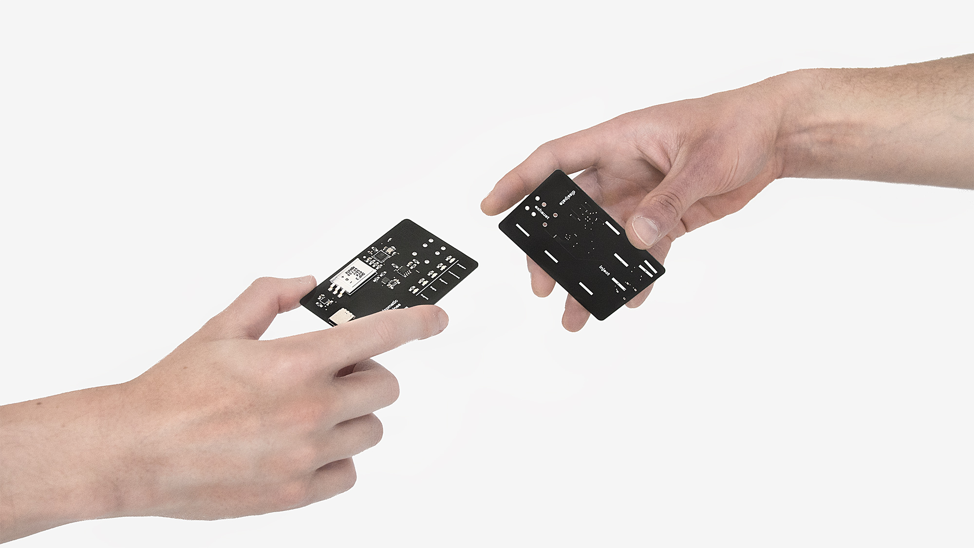
Notes:
What do we believe in?
Motivation talk

Slide 4
From bare metal to the cloud.
A full stack high end design solution.
Notes:
The device itself is a custom designed PCB with the latest technology available on the market.
* Custom magnet connector
* Secure & encrypted
* WiFi
* Supercapacitor Power Supply
* USB-C
* IoT
Blockchain
RoHS

Slide 5


Slide 6
Witness the first public intercourse:
www.rhizomaticmachines.com

Slide 7
Let’s talk business for a moment.

Slide 8
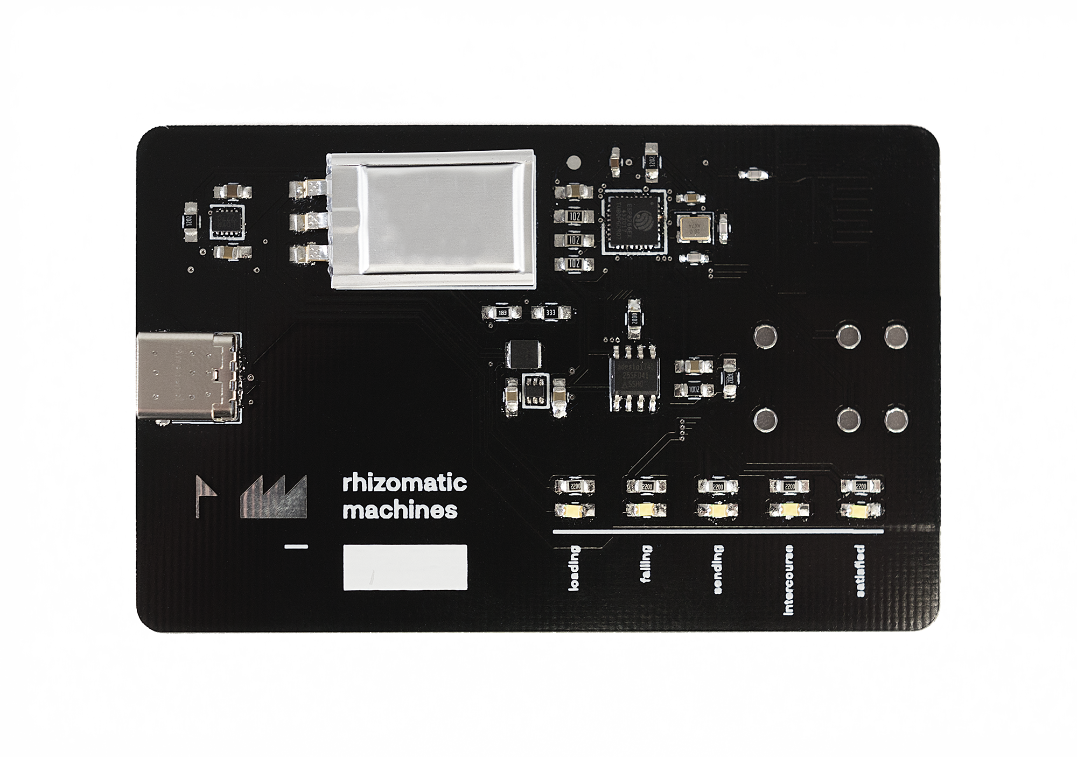

Slide 9
Social sandbox.
Notes:
Sandbox – This is what we do.
Explain possible use cases:
Collectible / Game
Offline interaction secure data transfer
Open source social network (you have to keep track of the hashes)
Social tiers for very well connected people (like in Black Mirror)
Everything involving mesh network connections

Slide 10
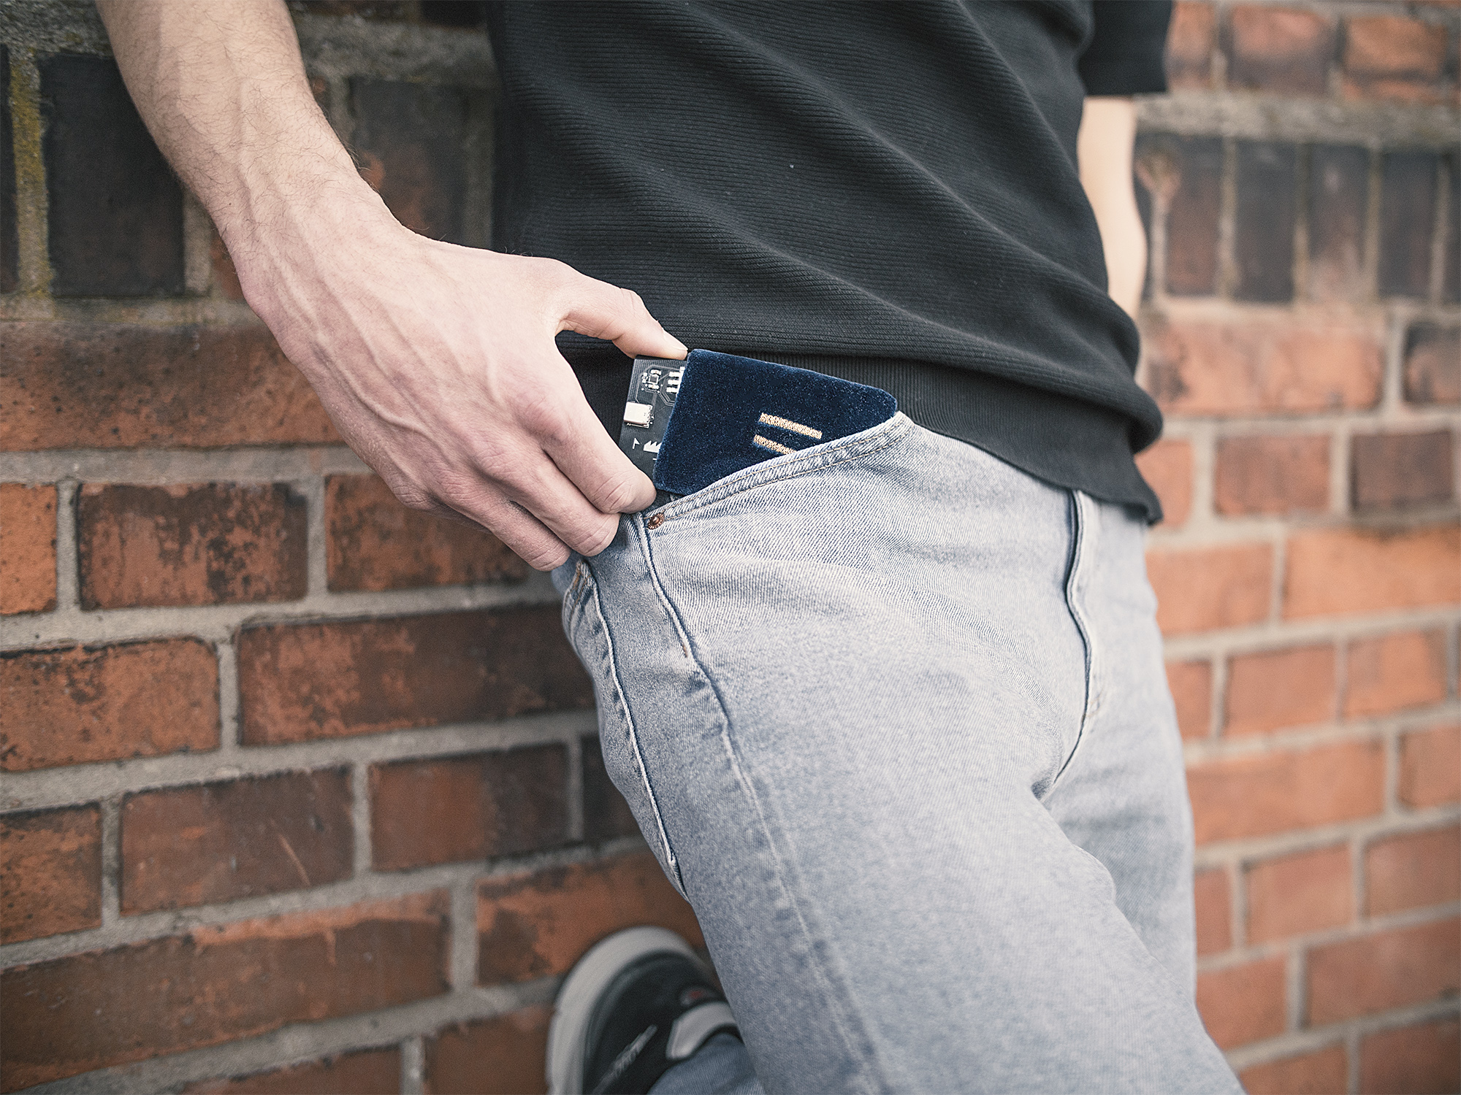
Sleeve and
cable included.
Notes:
This comes with the product.
Eco system
Pricing model

Slide 11
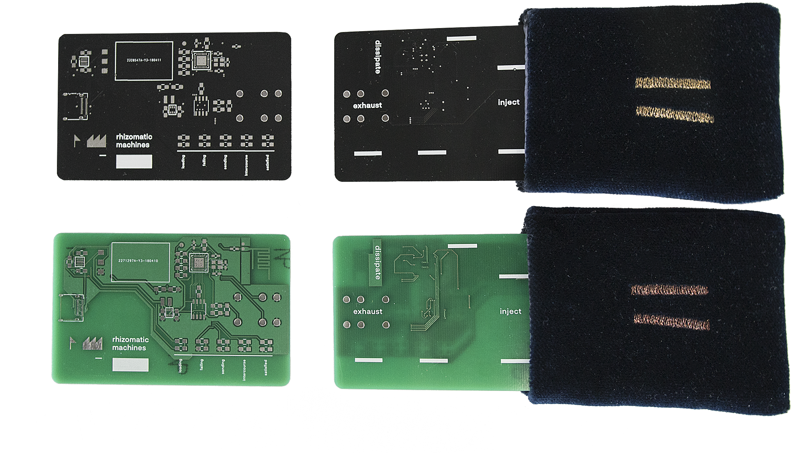
Notes:
This comes with the product.
Eco system
Pricing model

Slide 12
W E F U T U R E
Notes:
Milestone reached
Small batch production
Evaluation
Publicity
Mass Production

Slide 13
Visit our booth in Segment 7.
Thank you.
Notes:
Thank our friends and supervisors

